Slide 1
BIKE SHARING DEMAND ANALYSIS
Presented by Neetha B J
18 January 2026

Slide 2
OVERVIEW OF THE PROJECT
The Bike Sharing Demand Prediction project focuses on analyzing historical bike rental data to forecast future demand. Using machine learning models, the project predicts the number of bikes rented at a given hour or day based on various factors such as weather conditions, temperature, humidity, time of day, and season. The goal is to help bike-sharing companies optimize bike distribution, manage inventory, and improve customer satisfaction.

Slide 3
Features of the Project:
Predict hourly and daily bike rental demand.
Analyze the impact of weather, temperature, and humidity on bike usage.
Identify peak hours, days, and seasons for rentals.
Explore the difference in demand between working and non-working days.

Slide 4
DATASET DESCRIPTION:
The dataset contains weather information (Temperature, Humidity, Windspeed, Snowfall, Rainfall), the number of bikes rented per hour and date information.
Attribute Information:
Instant - Index
Dteday - date & day
Seasons - Winter, Summer & Rainy
Hr - Hour of he day(24hrs 0-23)
Holiday - False , Working – True
Weatherlist - 1,2,3 ( Too Hot, Too Cold, Messed)
atemp - Too Cold / Too hot (assuming)
Humidity - Climate
Casual - Trail attempt for Free
Registered - Common Customers
Cnt - Total count of Casual and Registered customers.

Slide 5
Implimentation on dataset
Merging different datasets into single excel files.
Data filtering and removing duplicate fields.
Implimenting different formulas to find exact values.
Pivort chart and pivot table to analyse the data.
Applying Conditional Formating.
Vlookup and Conditional Formating.
Creating interactive dashboard to predict the exact results at the same time.

Slide 6
Day-wise Bike sharing (Casual & Registered)

Slide 7
HUMIDITY LEVEL & TOTAL ENGAGE OF CNT

Slide 8
BIKE SHARING RATIO ON WEEKDAYS & HOLIDAY

Slide 9
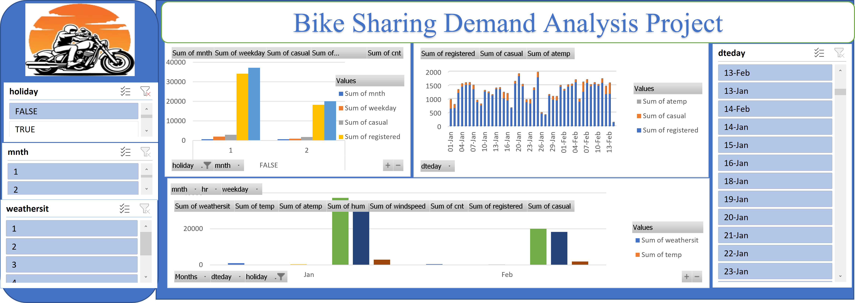
FINAL DASHBOARD

Slide 10
REFERENCES
DigiCromeAcademy
Bike Sharing Demand - https://www.kaggle.com/code/lakshmi25npathi/bike-sharing-demand-prediction
Decision Tree Learning - https://www.researchgate.net/publication/377641378_Using_machine_learning_for_bike_sharing_demand_prediction

Slide 11


